Slide 1
Introduction to SAP Transport Management
A brief introduction on the history and development of SAP Transport Management
by Anik Mandal

Slide 2
Contents
Abbreviations Used | 3
What is SAP? | 4
What is Transport Management? | 4
SAP as an Organisation | 5
Key parts of Domestic Transport Management | 6
SAP TM: Through the Years | 7
Areas of Operations of SAP TM | 10
SAP integrations | 11
Benefits of SAP | 12

Slide 3
Abbreviations Used in this Module
TM | Transportation Management
ERP | Enterprise Resource Planning
EDI | Electronic Data Interchange
WMS | Warehouse Management System
EWM | Extended Warehouse Management
LSP | Logistics Service Providers

Slide 4
What is SAP?
SAP is the name of the company and stands for System Applications and Products in Data Processing
SAP is also the name of the ERP Software
What is Transportation Management?
Includes transportational operations of all types
Tracking and maintaining every aspect of a vehicle
Mapping, routing
Logistics
EDI implementation

Slide 5
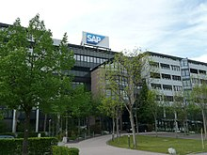

SAP as an Organisation
SAP was founded in 1972
SAP was founded by five former IBM Employees
Originally the name was Systemanalyse und Programmentwicklung in 1972
Name changed to Systeme, Anwendungen und Produkte in der Datenverarbeitung (SAP GmbH) in 1981
Presence in 180 countries with headquarters in Germany
Employs over 100,000 individuals with a revenue over 27.5 billion Euro (2019)

Slide 6
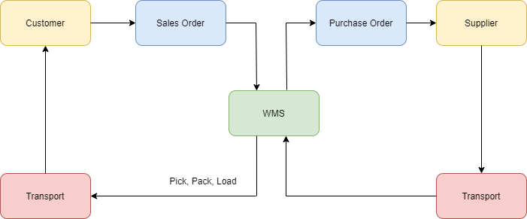
Key Parts of Domestic Transportation Management

Slide 7
SAP TM: Through the Years
1994
SAP ERP R/2 LE-TRA
Logistics Execution and Transportation
Shipment execution
Drawbacks:
Combining for inbound and outbound systems unavailable
Capacity Planning unavailable
Delivery based planning only
2000
SAP APO TP/VS
Transportaion Planning & Vehicle Scheduling
Shipment planning, optimisation and execution
Order Based Planning
ERP Integration
Drawbacks:
Combining for inbound and outbound systems unavailable

Slide 8
2009
SAP TM 6.0 & 7.0
Transportation Management
Integrated planning and execution
Prevalent stand-alone solution
Combination of Inbound and Outbound Systems
Charge Engine
Drawbacks:
Availability Restricted
TCO
2011
SAP TM 8.0
All-inclusive transportation functionality
Core processes for shippers and freight forwarders
Configurability and Usability greatly improved
Simplification of processes and performance
Advanced Costing and Settlement
Reduced Customer/ operation TCO

Slide 9
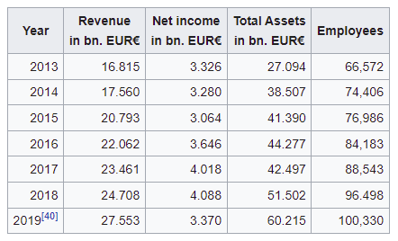
2012-2019
SAP TM 9.0-9.8
Transportation Management
Contract logistics, LSPs
Integration with EWM
Rail/Ocean/Air Carriers
Fleet management
Parcel management
Evolving for Retail/ Automotive/ Oil & Gas Industries
2015-Present
S/4HANA ERP & Finance
Supply Chain Execution Platform & S/4 Supply Chain
All-in-one solution
Removes multi-system and island landscape and replaces with
an integrated supply chain solution
Only system required to manage all TM needs in future
Capable of processing huge amounts of data in real time
Cost effective/reducing option

Slide 10
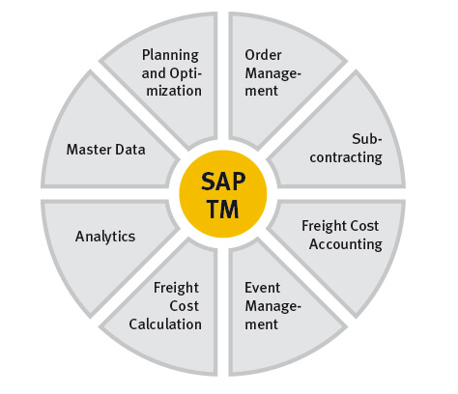
Areas of Operations of SAP TM

Slide 11
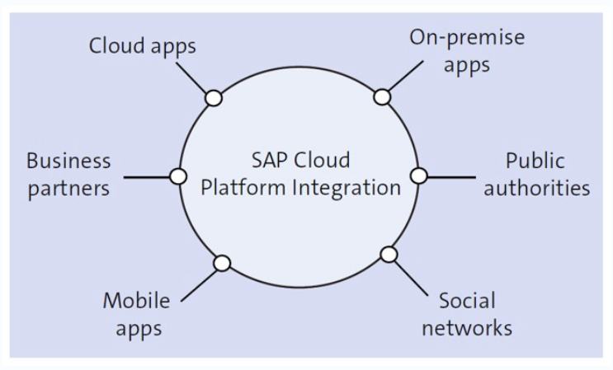
SAP integration with non SAP tools to provide a one-stop solution for clients

Slide 12
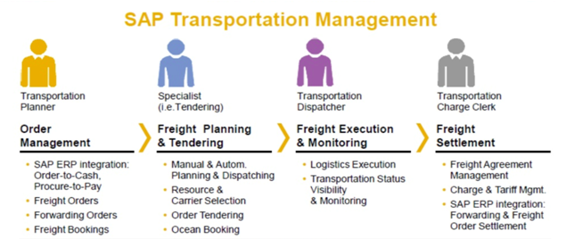
Benefits of SAP TM
Improved operational performance at reduced costs
Improved resource utilisation and carrier association
Improved visibilty of execution and responsiveness
Efficient Logistical demand fullfillment

Slide 13
Thank You

